Slide 1
Unit 6: Classification and Prediction

Slide 2
Support Vector Machine
Support Vector Machine or SVM is one of the most popular Supervised Learning algorithms, which is used for Classification as well as Regression problems.
However, primarily, it is used for Classification problems in Machine Learning.
A support vector machine takes input data points and outputs the hyperplane (which in two dimensions it’s simply a line) that best separates the data points into two classes.

Slide 3
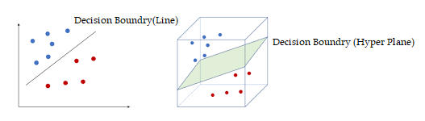
This line or hyperplane is the decision boundary: any data points that falls to one side of it is classified in one class and, and the data points that falls to the other of it is classified in another class.

Slide 4
Support vectors are data points that are closest to the hyperplane and influence the position and orientation of the hyperplane.
To separate the two classes of data points, there are many possible hyperplanes that could be chosen.
SVM algorithm selects optimal hyperplane by choosing hyperplane with largest margin. Such hyperplane is called maximum marginal hyperplane (MMH).

Slide 5
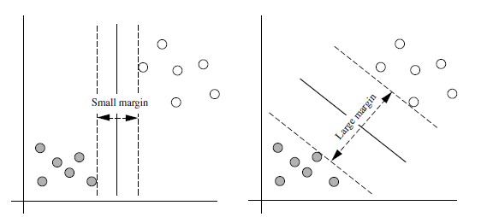
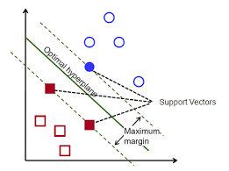
Let H1 and H2 are planes that passes through support vectors and parallel to the hyperplane of decision boundary.
Distance between plane H1 and the hyperplane should be equal to distance between plane H2 and the hyperplane. Margin is the distance between planes H1 and H2.

Slide 6
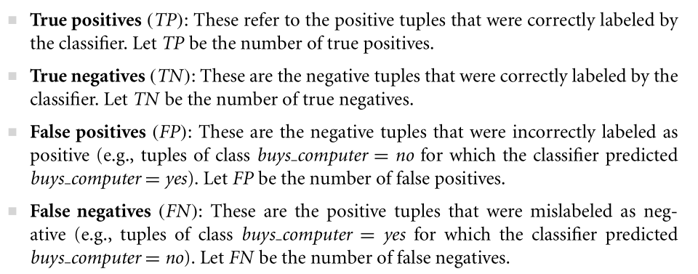
Evaluating Accuracy

Slide 7
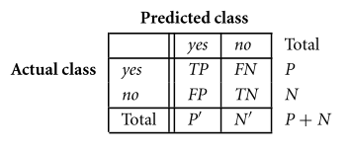
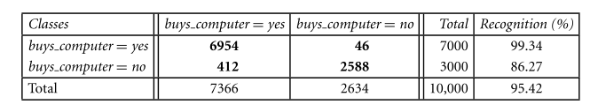

Slide 8
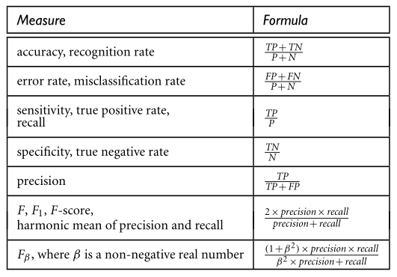

Slide 9
Overfitting
Overfitting is the result of using an excessively complicated model.
It happens when the model learns the details and noise of the training data to the extent that it negatively impacts the performance of the model on new data.
This means that the model learns noise or random fluctuations in the training data as concepts.
This negatively impacts the model's ability to generalize because these concepts do not apply to new data.

Slide 10
Underfitting
On the other hand, underfitting is the result of using an excessively simple model or using very few training samples.
in such situations, a machine learning algorithm cannot capture the underlying trend of the data.
Thus, it refers to a model that can neither model the training data nor generalize to new data.
Obviously an underfitted machine learning model is not a suitable model for making predictions because it has poor performance on the training data too.

Slide 11
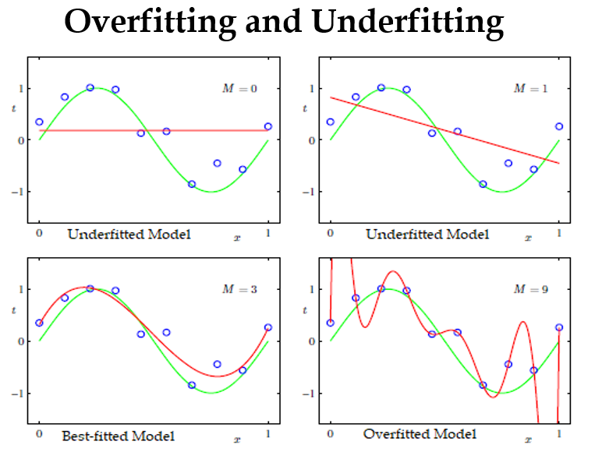

Slide 12
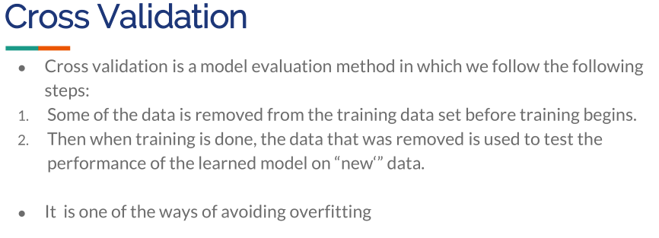

Slide 13
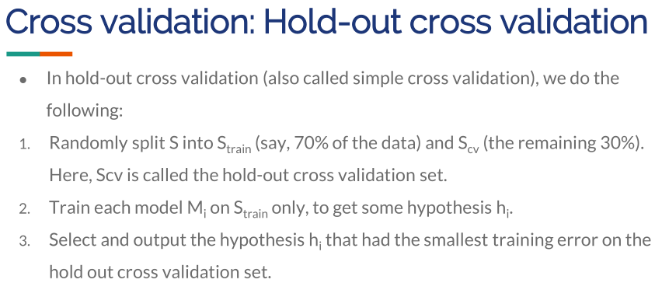

Slide 14
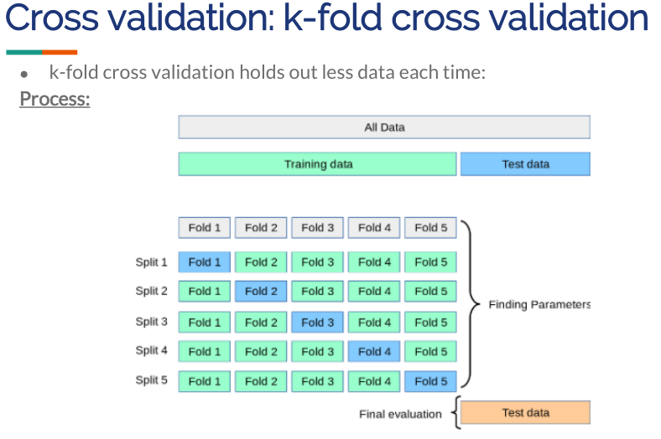

Slide 15
